Slide 1
Visualization of Screen Hits within the KEGG Pathway Database
Bessa Fan
Daniel Snider
Kafri Lab
November 27, 2017

Slide 2
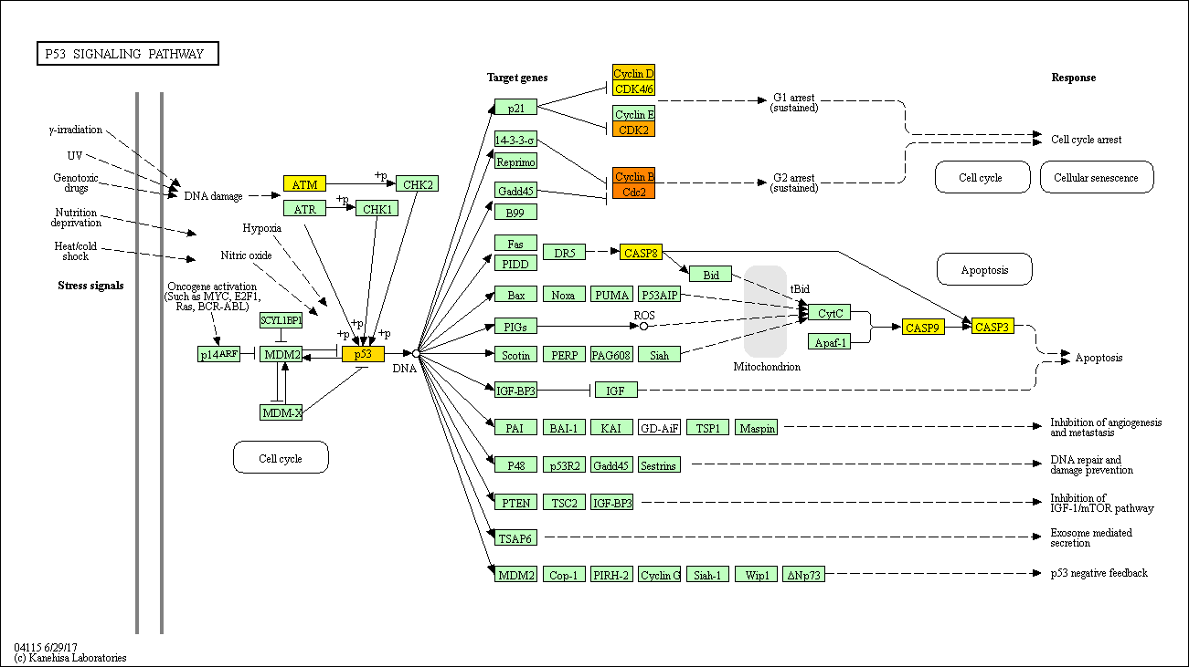
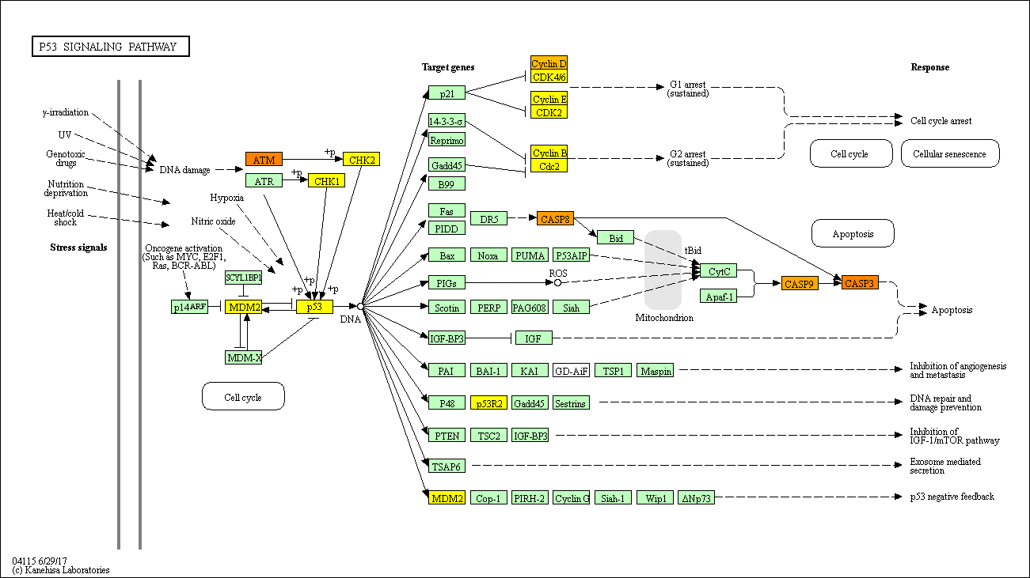
p53 Signalling Pathway – Homo sapiens (human) kegg hsa04115
On Axis G1
Off Axis G1
1
p-value
0

Slide 3
p53 Signalling Pathway – Homo sapiens (human) kegg hsa04115
Off Axis G1
On Axis G1
1
p-value
0

Slide 4
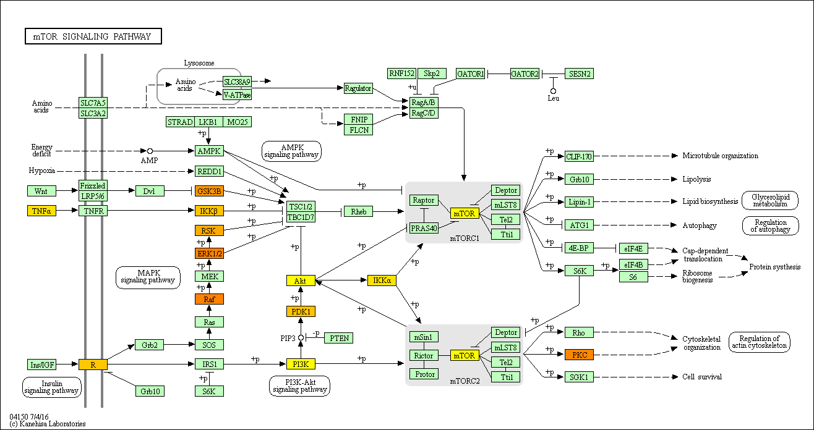
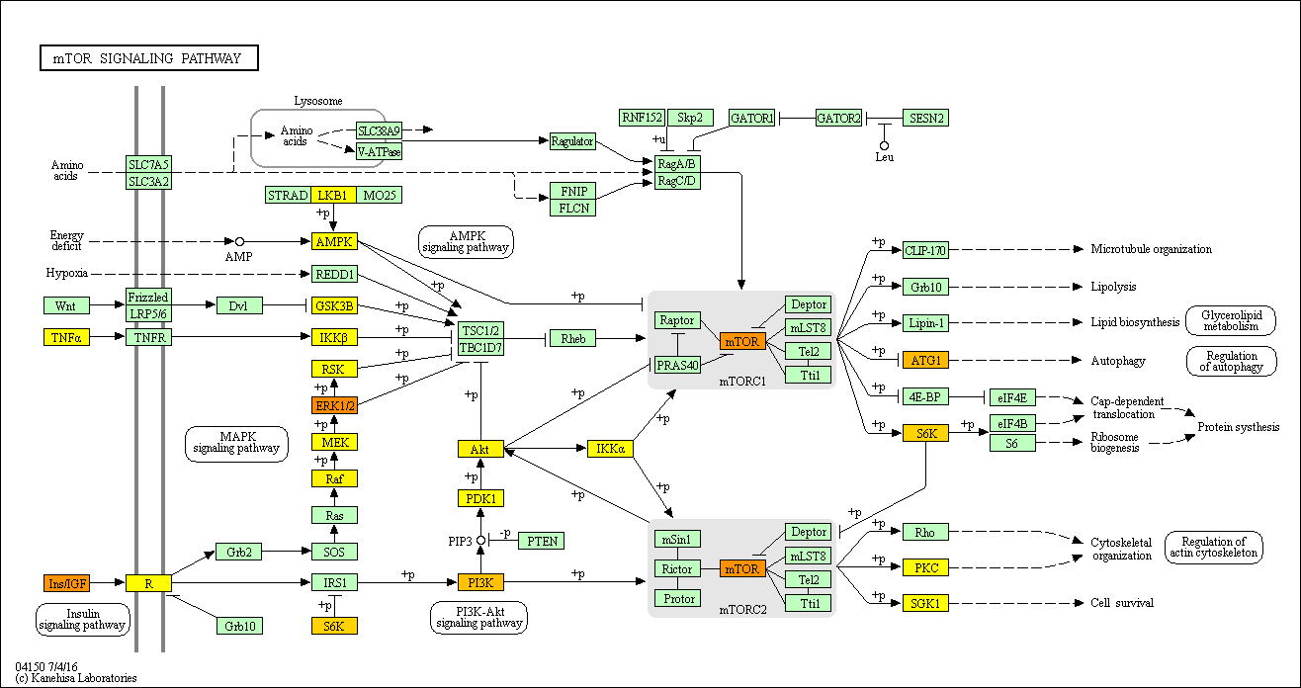
mTOR Signalling Pathway – Homo sapiens (human) kegg hsa04150
On Axis G1
Off Axis G1
1
p-value
0

Slide 5
mTOR Signalling Pathway – Homo sapiens (human) kegg hsa04150
Off Axis G1
On Axis G1
1
p-value
0

Slide 6
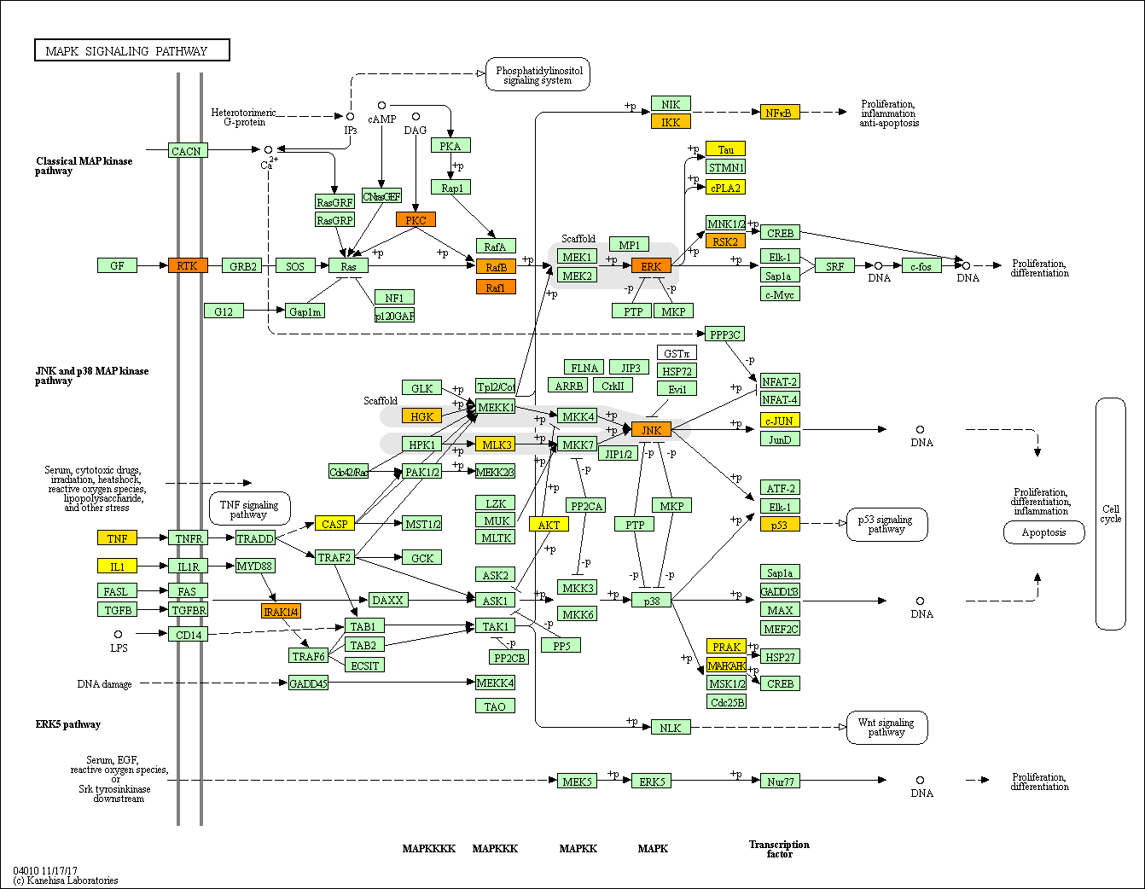
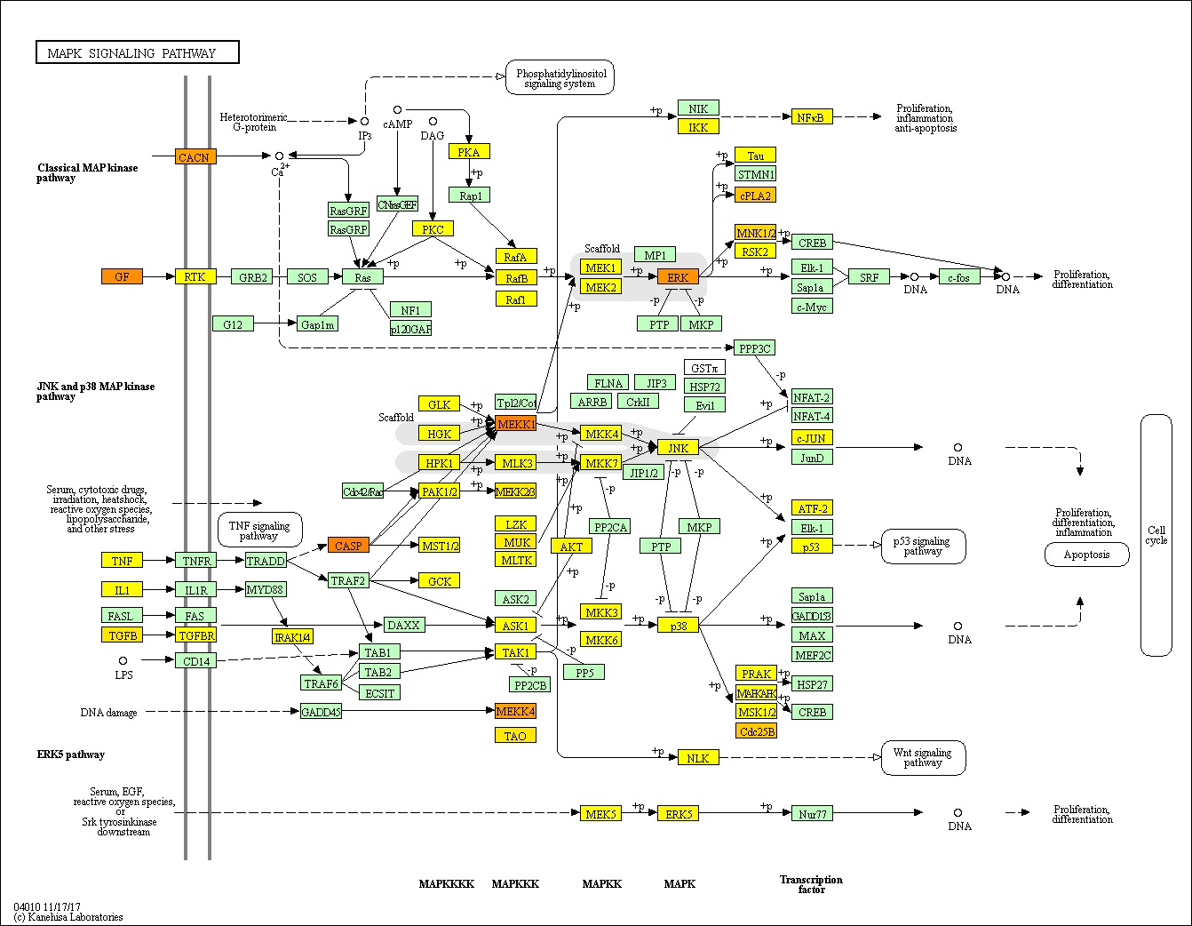
MAPK Signalling Pathway – Homo sapiens (human) kegg hsa04010
On Axis G1
Off Axis G1
1
p-value
0

Slide 7
MAPK Signalling Pathway – Homo sapiens (human) kegg hsa04010
Off Axis G1
On Axis G1
1
p-value
0

Slide 8
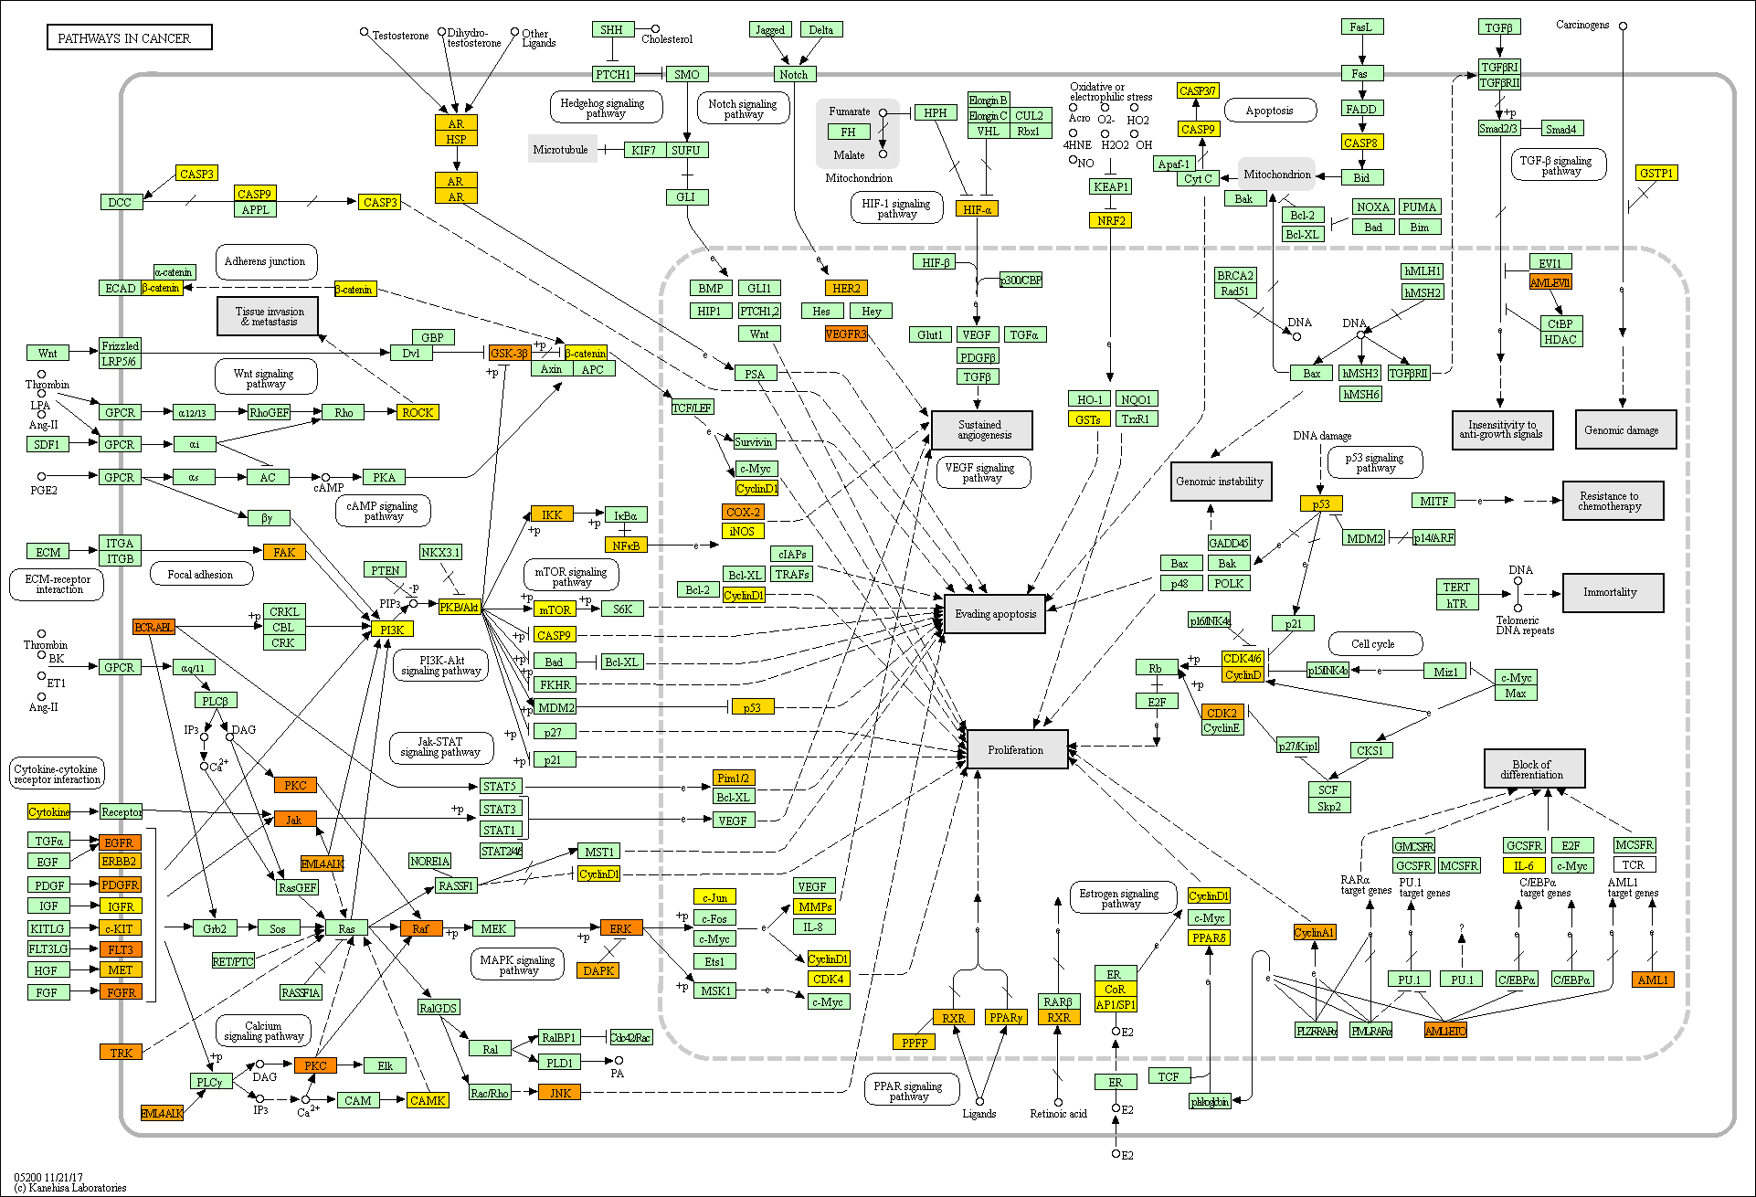
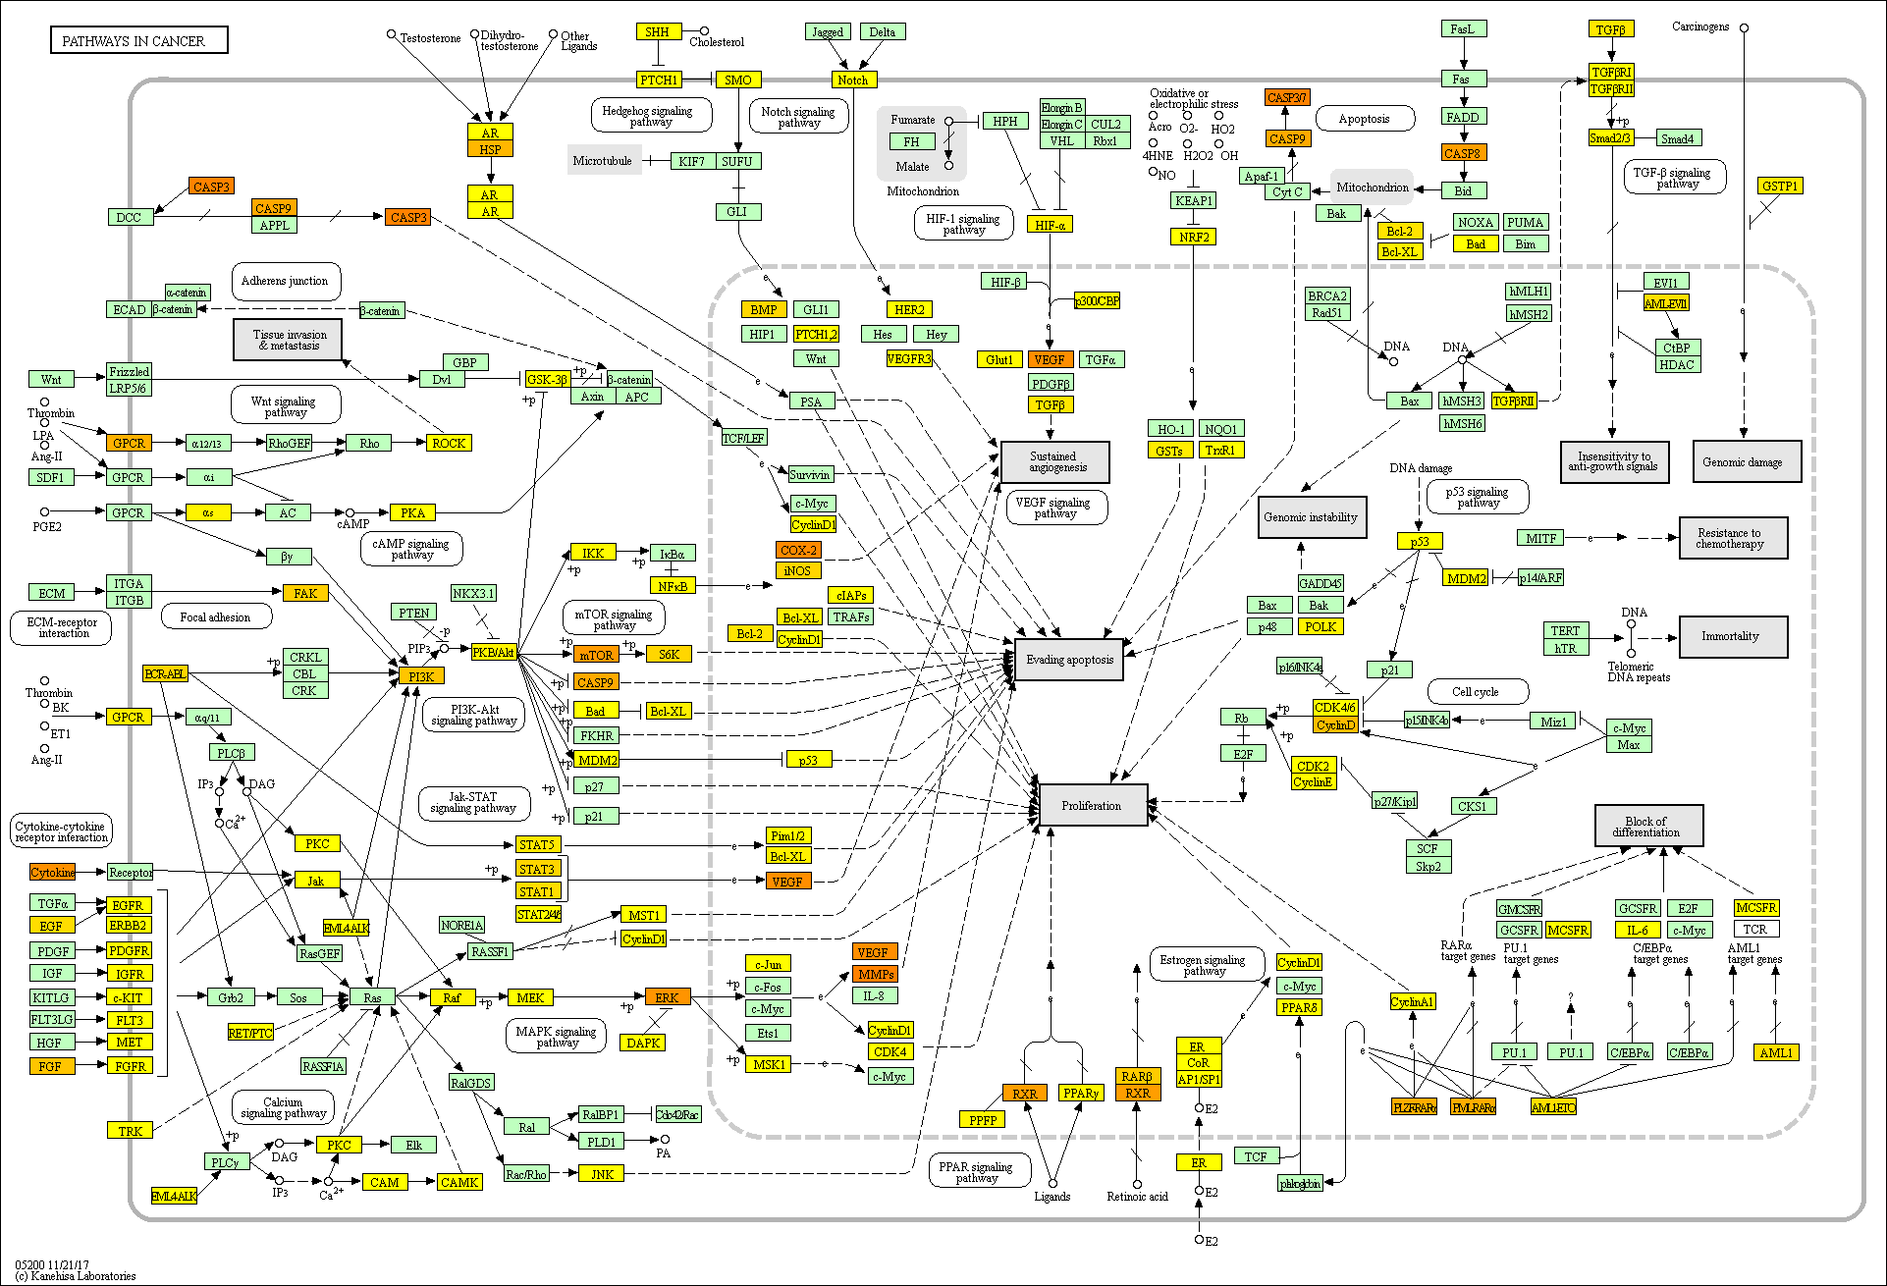
Pathways in cancer – Homo sapiens (human) kegg hsa05200
On Axis G1
Off Axis G1
1
p-value
0

Slide 9
Pathways in cancer – Homo sapiens (human) kegg hsa05200
Off Axis G1
On Axis G1
1
p-value
0

Slide 10
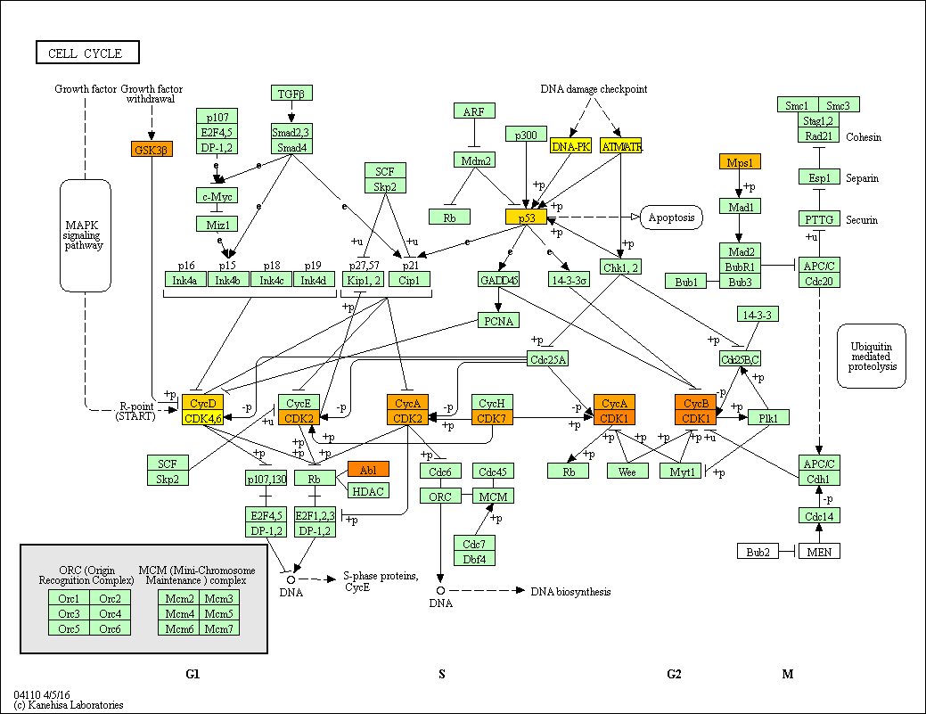
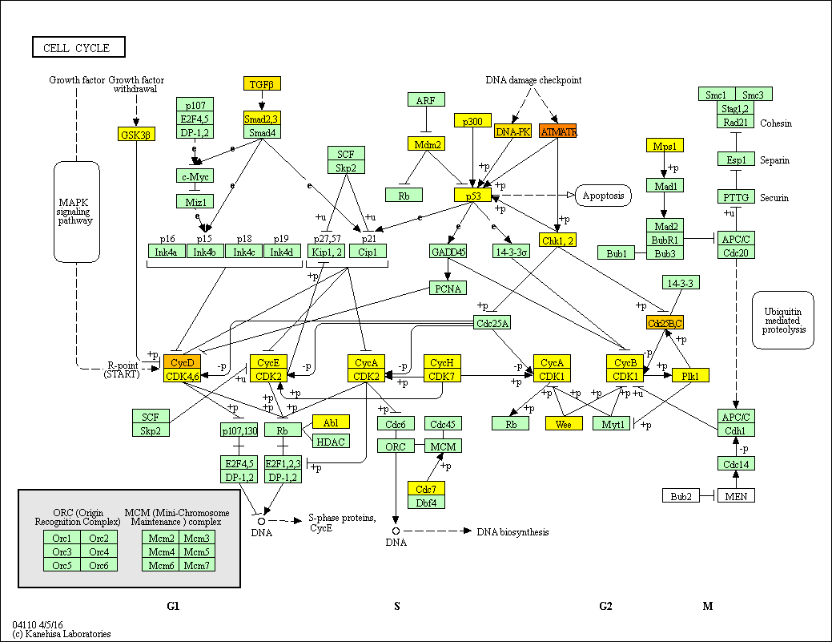
Cell Cycle Pathway – Homo sapiens (human) kegg hsa04110
On Axis G1
Off Axis G1
1
p-value
0

Slide 11
Cell Cycle Pathway – Homo sapiens (human) kegg hsa04110
Off Axis G1
On Axis G1
1
p-value
0

Slide 12
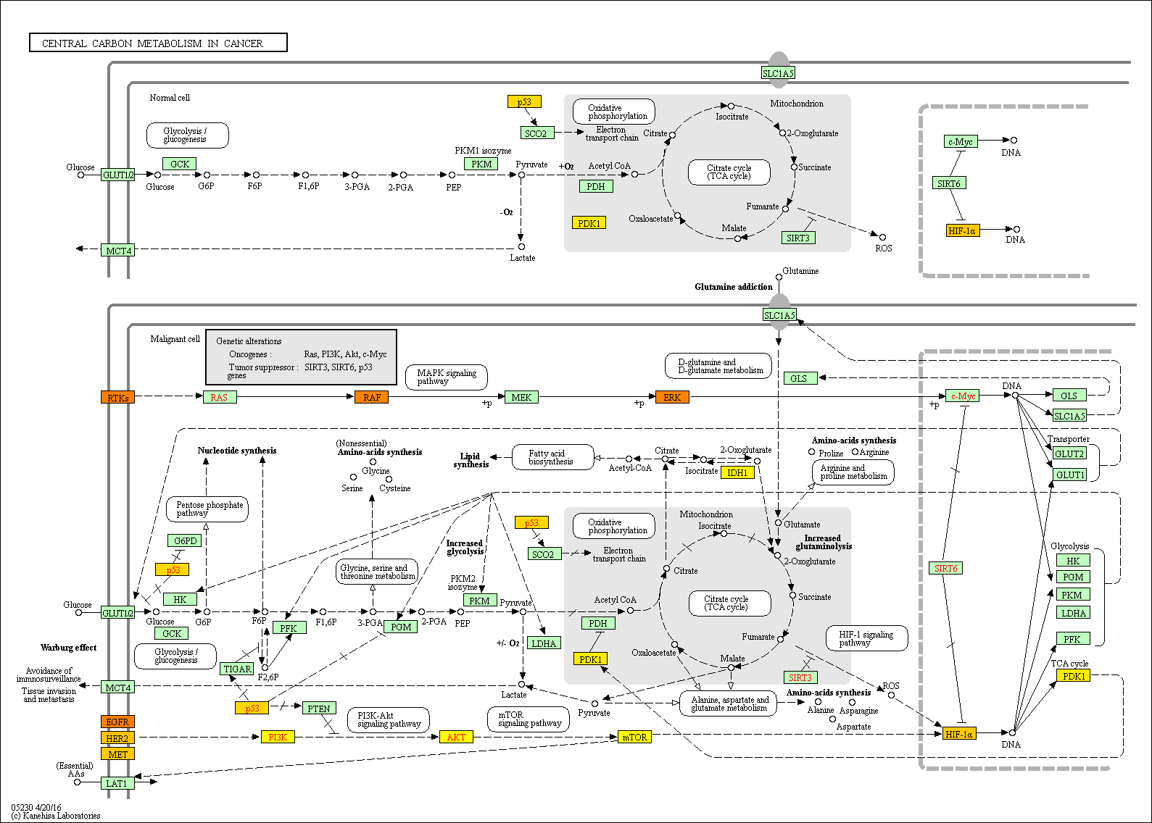
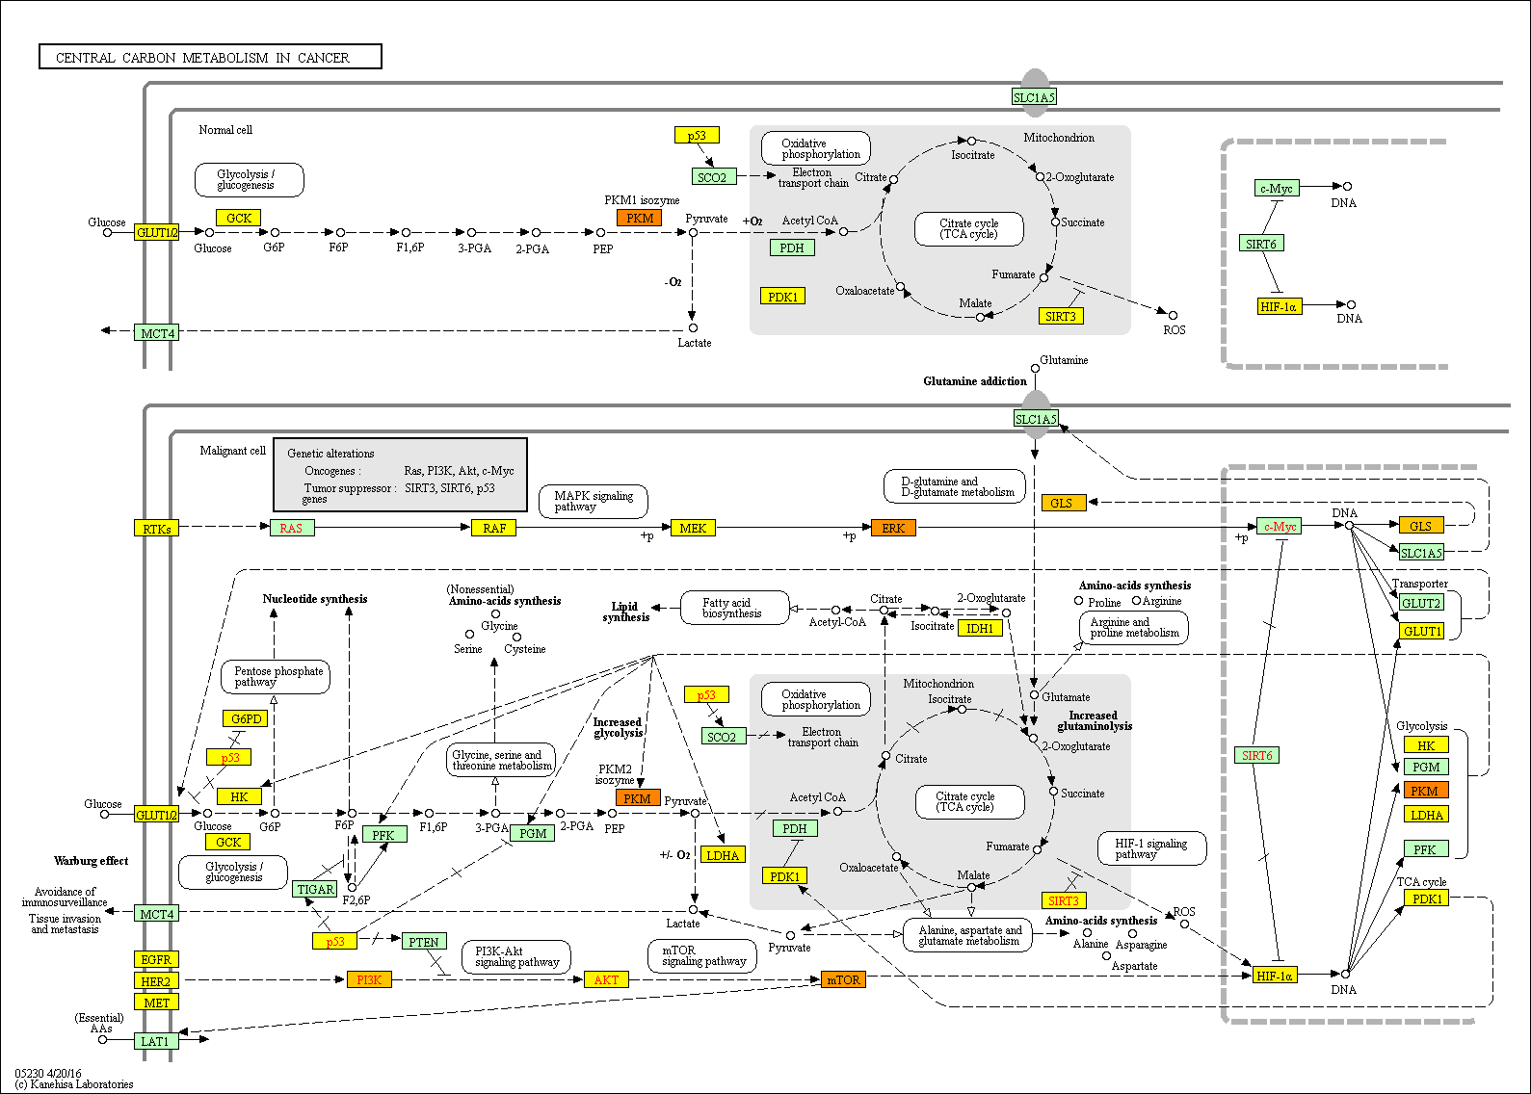
Central carbon metabolism in cancer (human) kegg hsa05230
On Axis G1
Off Axis G1
1
p-value
0

Slide 13
Central carbon metabolism in cancer (human) kegg hsa05230
Off Axis G1
On Axis G1
1
p-value
0

